Slide 1
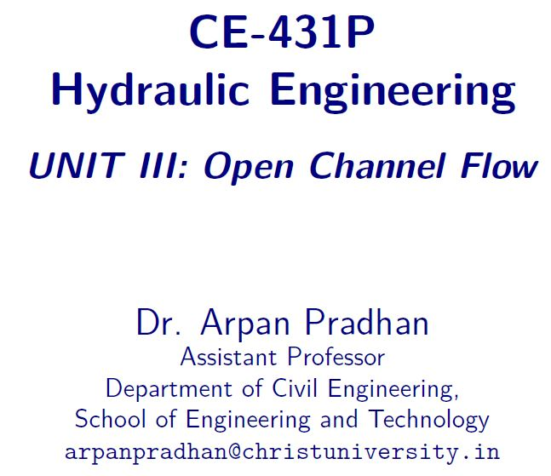

Slide 2
Contents
Velocity Distribution
Energy and Momentum Coefficient
Continuity Equation
Energy Equation
Momentum Equation

Slide 3
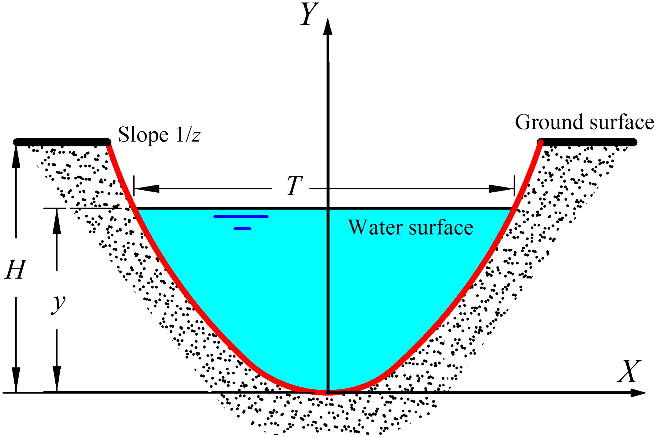
channel section

Slide 4
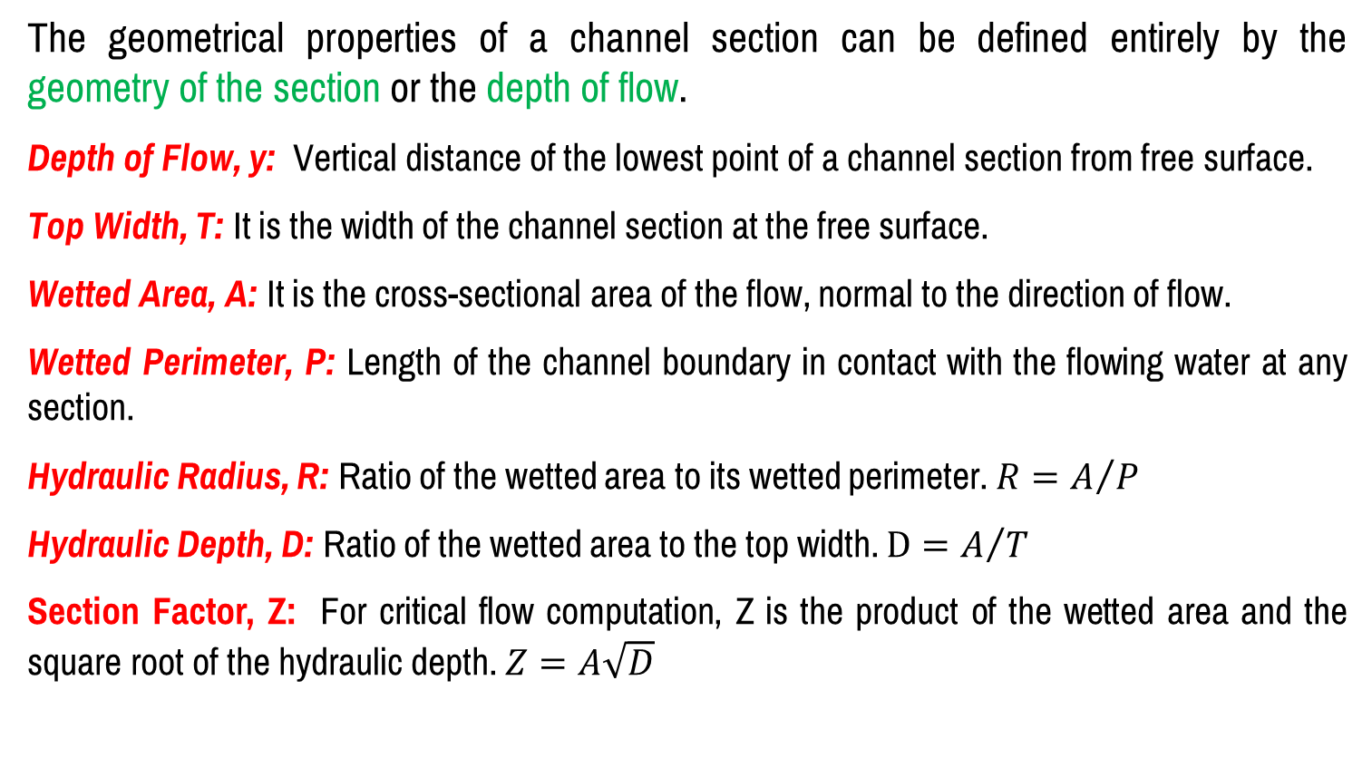
Geometric parameters of channel section
The geometrical properties of a channel section can be defined entirely by the geometry of the section or the depth of flow.
Depth of Flow, y: Vertical distance of the lowest point of a channel section from free surface.
Top Width, T: It is the width of the channel section at the free surface.
Wetted Area, A: It is the cross-sectional area of the flow, normal to the direction of flow.
Wetted Perimeter, P: Length of the channel boundary in contact with the flowing water at any section.
Hydraulic Radius, R: Ratio of the wetted area to its wetted perimeter. $R=A/P$
Hydraulic Depth, D: Ratio of the wetted area to the top width. $D=A/T$
Section Factor, Z: For critical flow computation, Z is the product of the wetted area and the square root of the hydraulic depth. $Z=A\sqrt{D}$

Slide 5
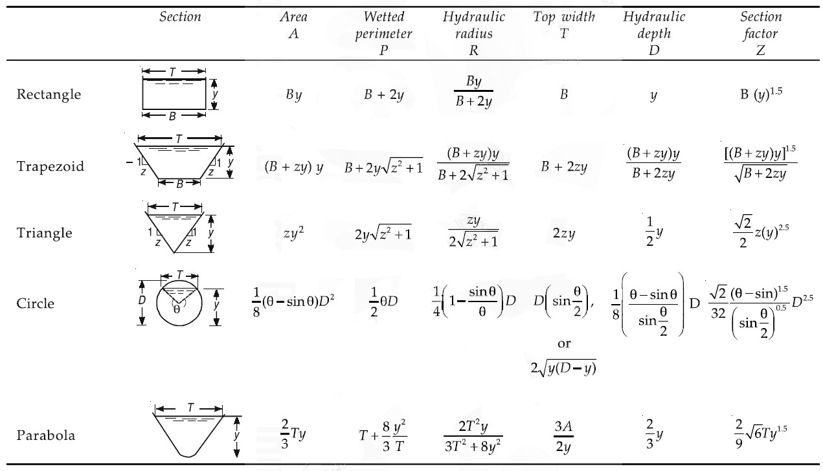
Geometric elements of channel section

Slide 6
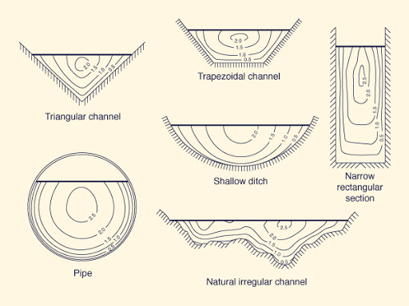
Velocity Distribution of channel section
The flow velocity in a channel section varies from one point to another. This is due to shear stress at the bottom and at the sides of the channel and due to the presence of free surface.

Slide 7
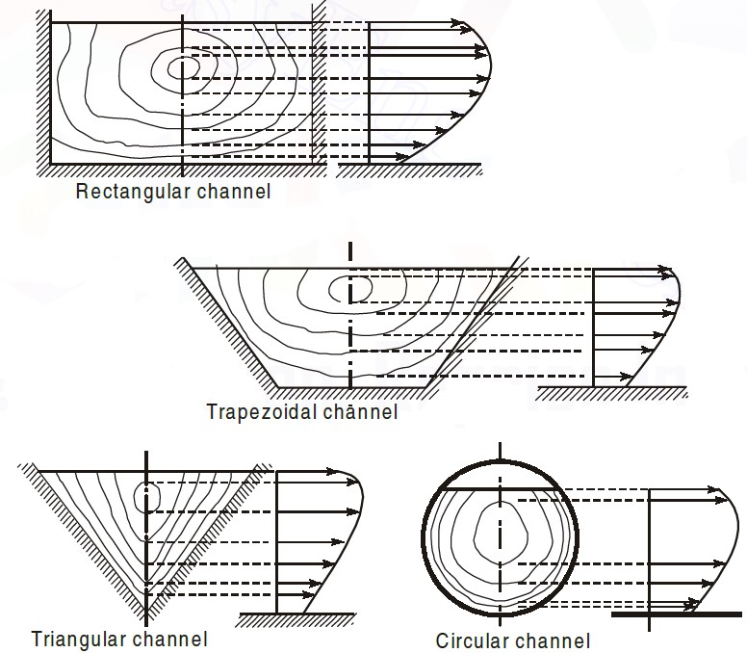
Velocity Distribution of channel section

Slide 8

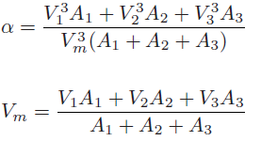
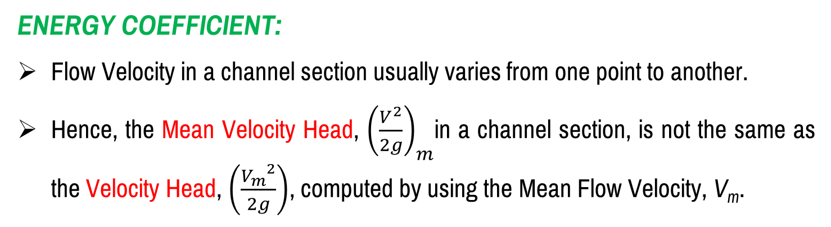
Energy and momentum coefficient
Energy Coefficient:
Flow Velocity in a channel section usually varies from one point to another.
Hence, the Mean Velocity Head, ${\left(\frac{V^{2}}{2g}\right)}_{m}$in a channel section, is not the same as the Velocity Head, $\left(\frac{{V_{m}}^{2}}{2g}\right)$, computed by using the Mean Flow Velocity, V_{m}.

Slide 9

Energy and momentum coefficient
momentum Coefficient:
Similar to the energy coefficient, a coefficient for the momentum transfer through a channel section may be introduced to account for nonuniform velocity distribution.
This coefficient, also called Boussinesq coefficient, is denoted by β. An expression for this may be obtained as follows.

Slide 10
Conservation laws
Three Conservation Laws describe steady, free-surface flows
Conservation of Mass
Conservation of Momentum
Conservation of Energy
For simplicity, only one-dimensional flows are considered.
In these flows, the flow velocity is only in the direction of flow and the components of flow velocity in the transverse and vertical directions are zero.

Slide 11
Conservation laws
Conservation of Mass
This principle says that the mass neither be created nor destroyed. This forms the basis for continuity equation.
Conservation of Energy
This principle says that the energy neither be created nor destroyed, only can change the form.
Conservation of Momentum
The interaction of force and time acting on the object is equal to the change in momentum of the object.

Slide 12
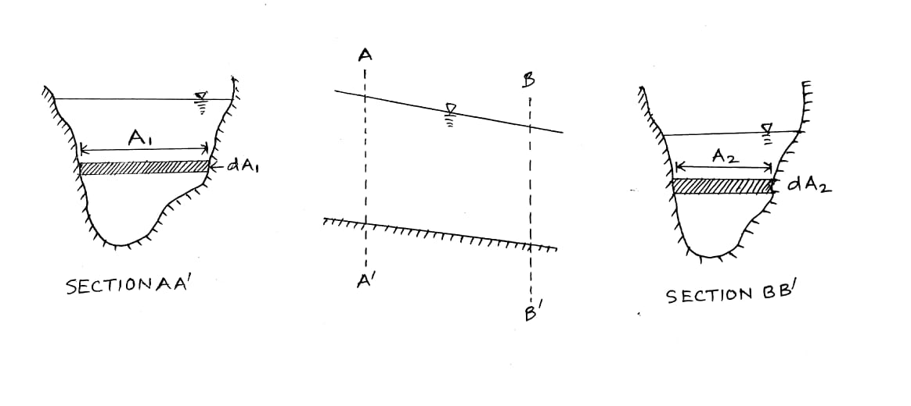


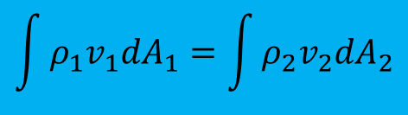
Conservation laws – Conservation of Mass
$$\int{ρ_{1}v_{1}{dA}_{1}}=\int{ρ_{2}v_{2}{dA}_{2}}$$
$$V_{1}A_{1}=V_{2}A_{2}$$
$$Q_{1}=Q_{2}$$

Slide 13
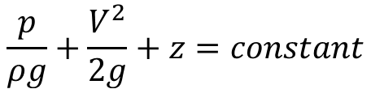
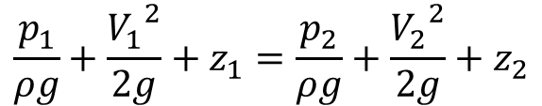
Conservation laws – Conservation of Energy
The Total Energy Head at a point in an open channel is the sum of the potential and kinetic energy of the flowing water.
The energy per unit weight is the sum of pressure head or static head, velocity head or kinetic head and potential head.
For steady irrotational flow these sum are constant.
$$\frac{p}{ρg}+\frac{V^{2}}{2g}+z=constant$$
$$\frac{p_{1}}{ρg}+\frac{{V_{1}}^{2}}{2g}+z_{1}=\frac{p_{2}}{ρg}+\frac{{V_{2}}^{2}}{2g}+z_{2}$$

Slide 14
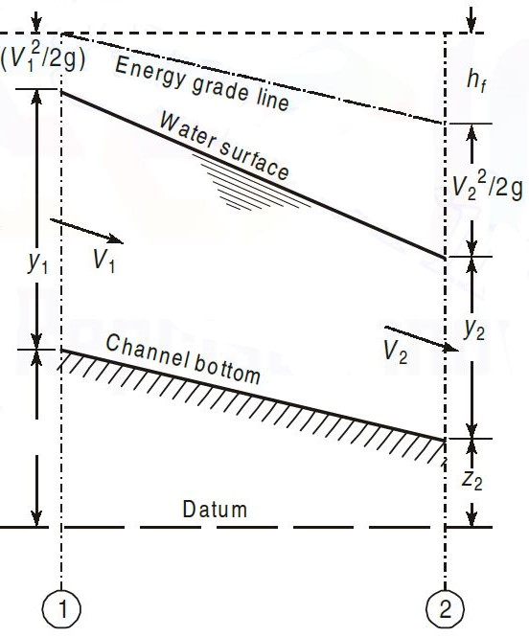
Conservation laws – Conservation of Energy

Slide 15
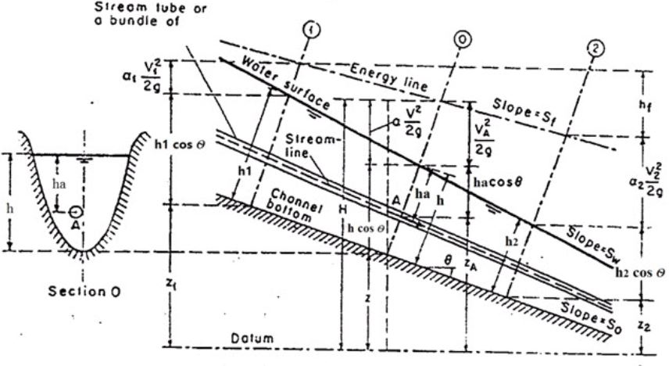
Conservation laws – Conservation of Energy

Slide 16
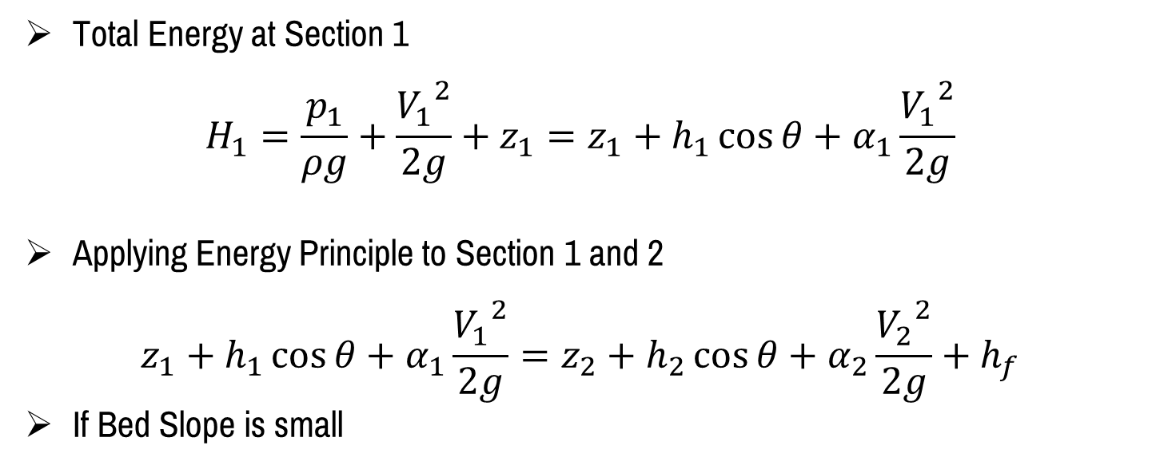
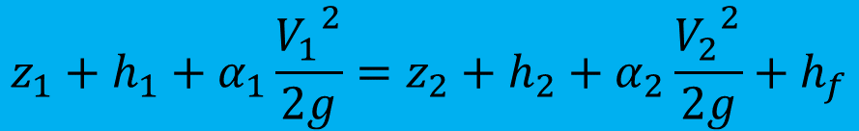
Conservation laws – Conservation of Energy
Total Energy at Section 1
$$H_{1}=\frac{p_{1}}{ρg}+\frac{{V_{1}}^{2}}{2g}+z_{1}=z_{1}+h_{1}\cos{θ}+α_{1}\frac{{V_{1}}^{2}}{2g}$$
Applying Energy Principle to Section 1 and 2
$$z_{1}+h_{1}\cos{θ}+α_{1}\frac{{V_{1}}^{2}}{2g}=z_{2}+h_{2}\cos{θ}+α_{2}\frac{{V_{2}}^{2}}{2g}+h_{f}$$
If Bed Slope is small
$$z_{1}+h_{1}+α_{1}\frac{{V_{1}}^{2}}{2g}=z_{2}+h_{2}+α_{2}\frac{{V_{2}}^{2}}{2g}+h_{f}$$

Slide 17
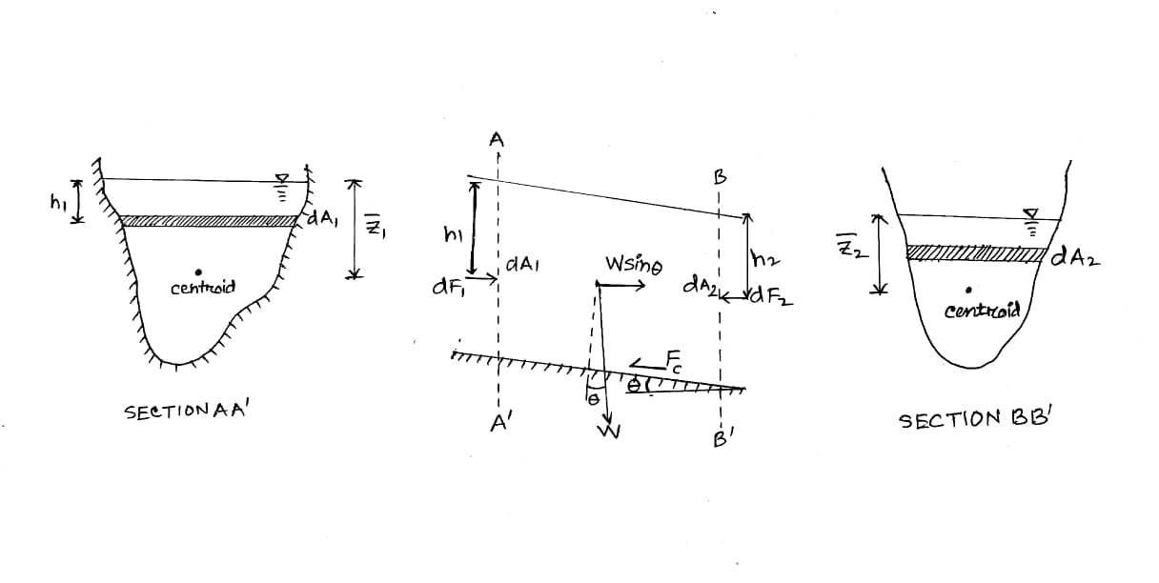
Conservation laws – Conservation of Momentum
To derive an equation describing conservation of momentum, let us consider the steady flow of an incompressible liquid in a channel.

Slide 18
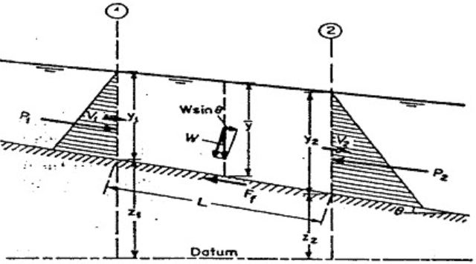

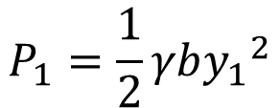


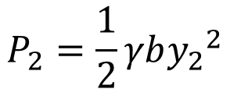
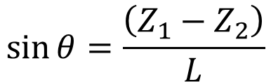
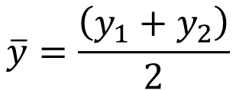
Conservation laws – Conservation of Momentum
$$P_{1}=\frac{1}{2}γb{y_{1}}^{2}$$
$$P_{2}=\frac{1}{2}γb{y_{2}}^{2}$$
$$F_{f}=γh_{f}b\overline{y}$$
$$W=γb\overline{y}L$$
Sum of Forces: $P_{1}−P_{1}+W\sin{θ}−F_{f}$
$$\overline{y}=\frac{\left(y_{1}+y_{2}\right)}{2}$$
$$\sin{θ}=\frac{\left(Z_{1}−Z_{2}\right)}{L}$$

Slide 19
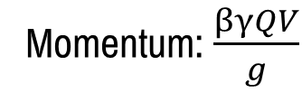
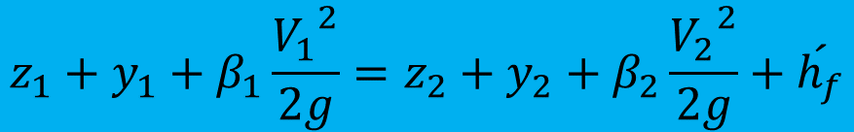
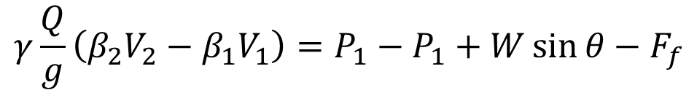
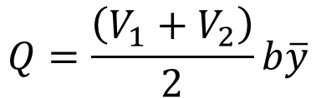
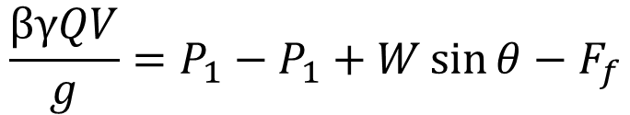
Conservation laws – Conservation of Momentum
The momentum of the flow passing the channel section per unit time is expressed as
Momentum: $\frac{βγQV}{g}$
$$Q=\frac{\left(V_{1}+V_{2}\right)}{2}b\overline{y}$$
$$\frac{βγQV}{g}=P_{1}−P_{1}+W\sin{θ}−F_{f}$$
$$γ\frac{Q}{g}\left(β_{2}V_{2}−β_{1}V_{1}\right)=P_{1}−P_{1}+W\sin{θ}−F_{f}$$
$$z_{1}+y_{1}+β_{1}\frac{{V_{1}}^{2}}{2g}=z_{2}+y_{2}+β_{2}\frac{{V_{2}}^{2}}{2g}+\acute{h_{f}}$$

Slide 20
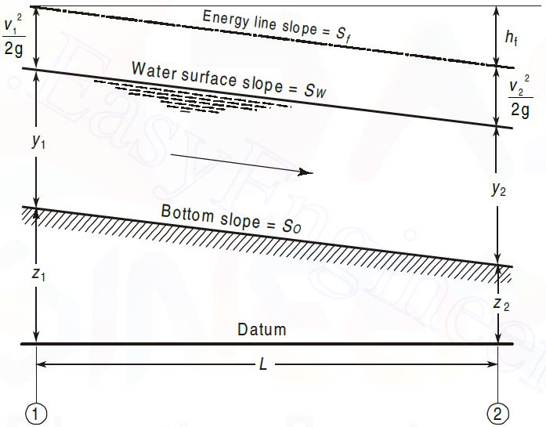
Uniform flow

Slide 21
Uniform flow
Main features
The depth of flow, wetted area, velocity of flow and discharge are constant at every section along the channel reach.
The total energy line, water surface and the channel bottom are all parallel, that is, their slopes are all equal, or S_{f} = S_{w} = S₀ = S

Slide 22
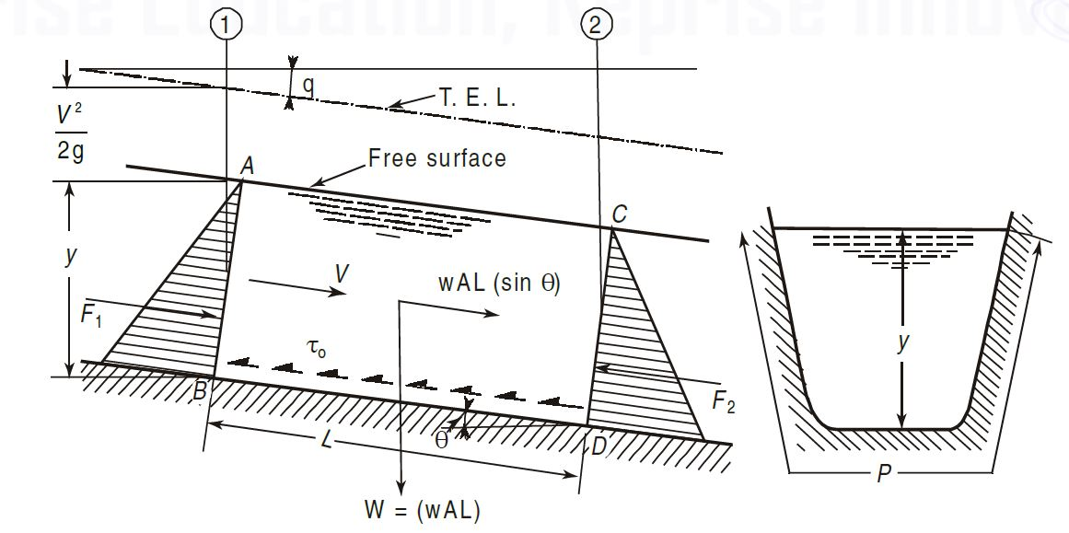

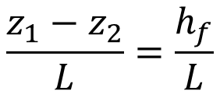

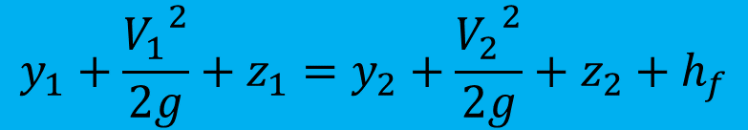
Uniform flow
$$z_{1}−z_{2}=h_{f}$$
$$y_{1}+\frac{{V_{1}}^{2}}{2g}+z_{1}=y_{2}+\frac{{V_{2}}^{2}}{2g}+z_{2}+h_{f}$$
$$\frac{z_{1}−z_{2}}{L}=\frac{h_{f}}{L}$$
$$S_{0}=S_{f}=S_{w}$$

Slide 23
Uniform flow - Fundamental Eq.
The depth of a Uniform Flow is called as Normal Depth, denoted by y_{n}
The fundamental equation for uniform flow in channels may be derived by applying Newton’s second law of motion.
In uniform flow since the velocity of flow does not change along the length of the channel, there is no acceleration.
Hence the sum of the components of all the external forces in the direction of flow must be equal to zero.

Slide 24

Uniform flow - Fundamental Eq.
$$wAL\sin{θ}−PLτ_{0}=0$$

Slide 25

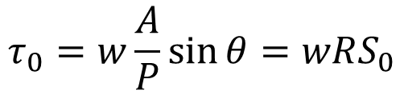
Uniform flow - Fundamental Eq.
$$wAL\sin{θ}−PLτ_{0}=0$$
$$τ_{0}=w\frac{A}{P}\sin{θ}=wRS_{0}$$

Slide 26
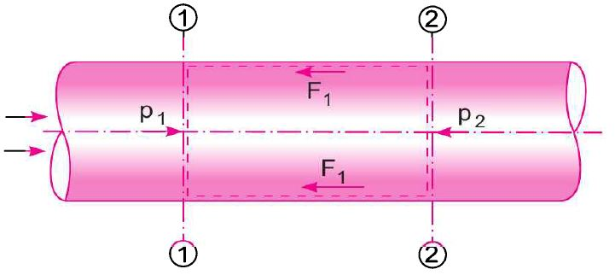
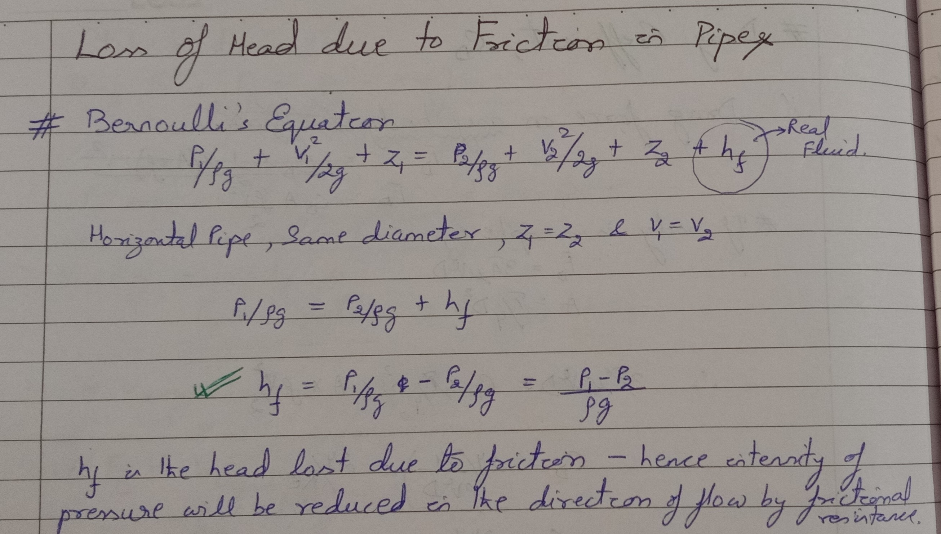
FRICTIONAL LOSS – Expression For Loss Of Head

Slide 27
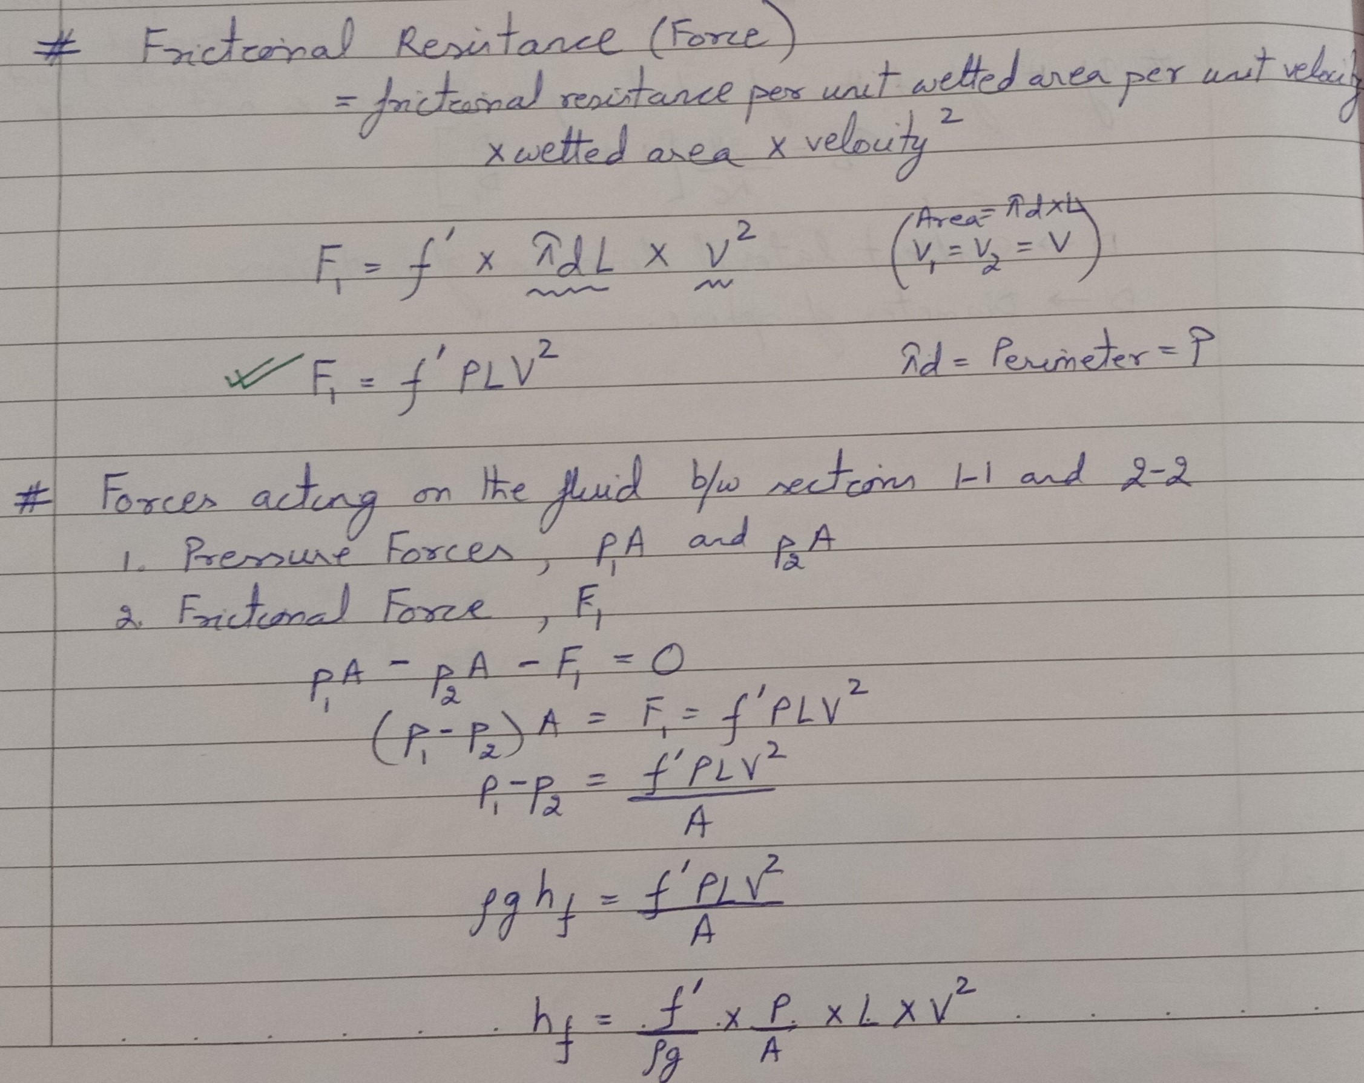
FRICTIONAL LOSS – Expression for Loss Of Head

Slide 28
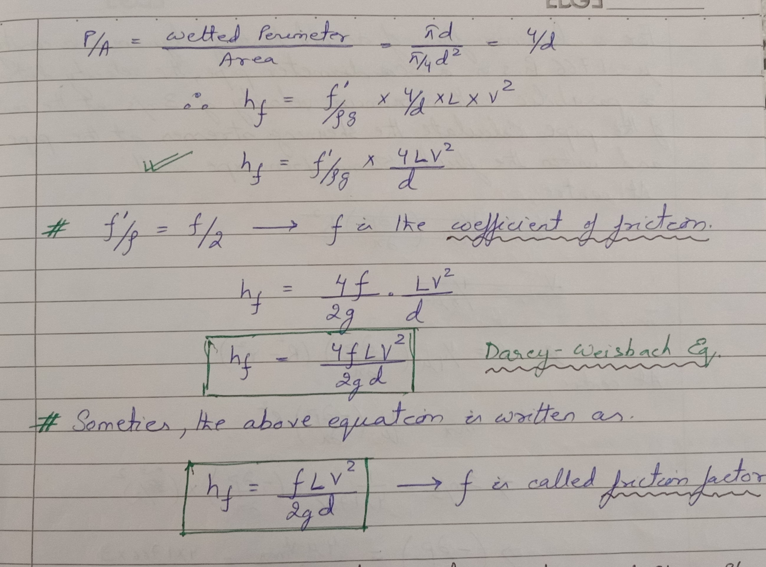
FRICTIONAL LOSS – Expression for Loss Of Head

Slide 29
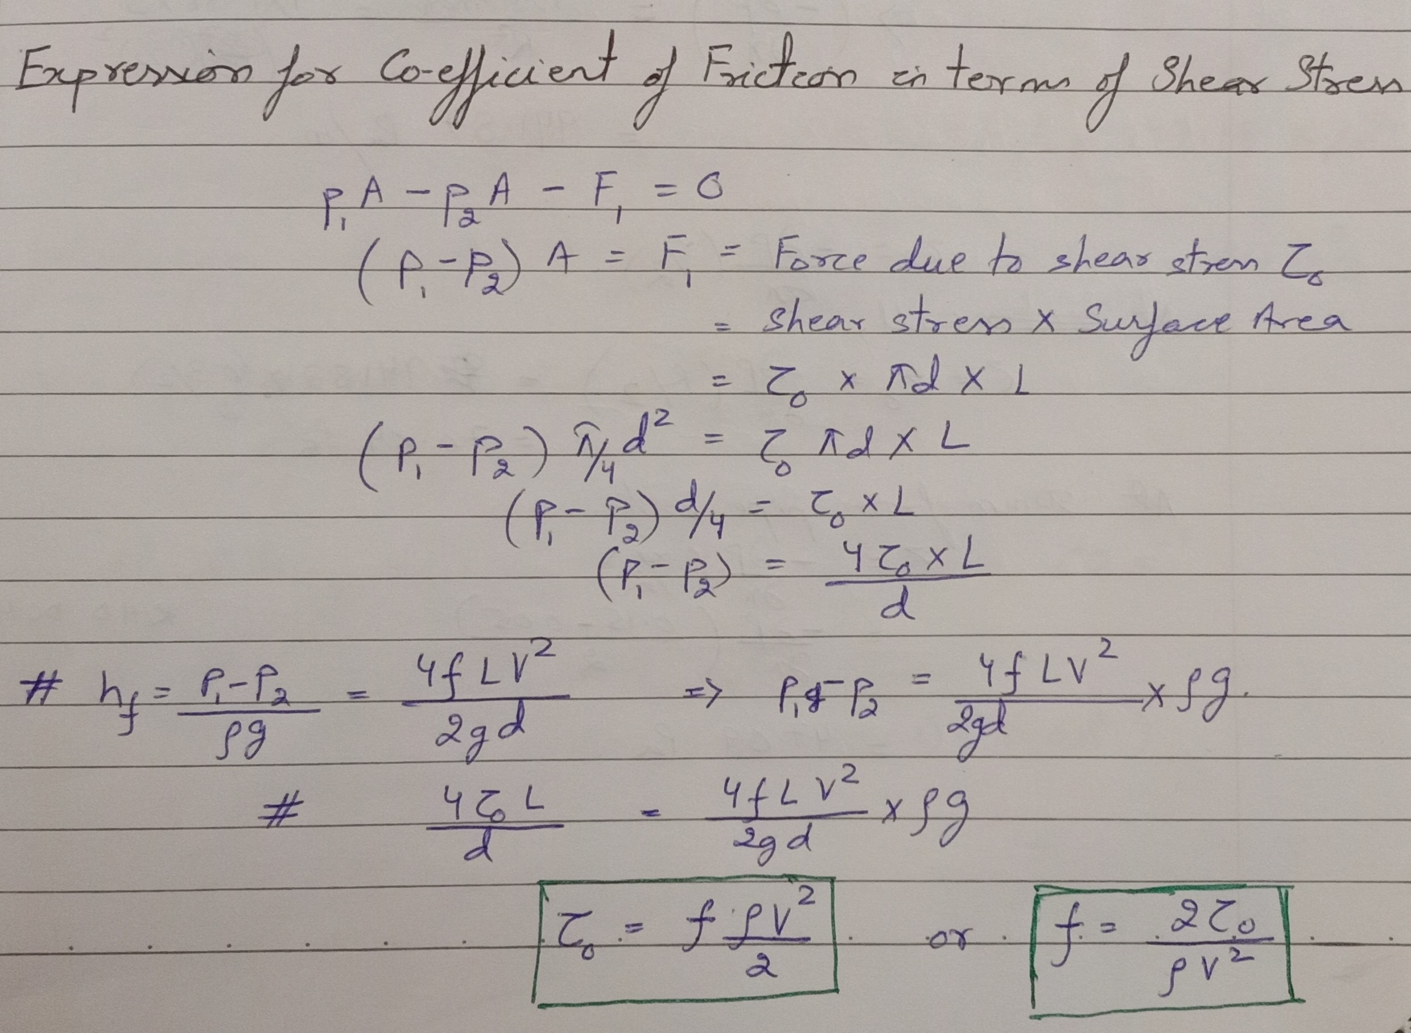
Coefficient of FRICTION – In terms of Shear Stress

Slide 30

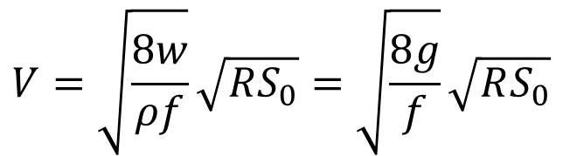
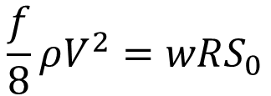
Uniform flow - Fundamental Eq.
$$wAL\sin{θ}−PLτ_{0}=0$$
$$τ_{0}=w\frac{A}{P}\sin{θ}=wRS_{0}$$
$$\frac{f}{8}ρV^{2}=wRS_{0}$$
$$V=\sqrt{\frac{8w}{ρf}}\sqrt{RS_{0}}=\sqrt{\frac{8g}{f}}\sqrt{RS_{0}}$$
$$V=C\sqrt{RS_{0}}$$

Slide 31

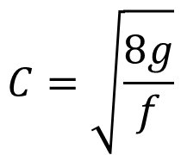
Uniform flow – chezy’s formula
$$V=C\sqrt{RS_{0}}$$
$$C=\sqrt{\frac{8g}{f}}$$
Chezy’s coefficient is not a dimensionless coefficient; has the dimensions [L^{1/2} T^{–1}]

Slide 32
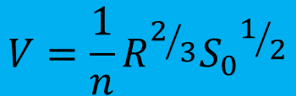
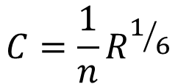
Uniform flow – manning formula
Mean Velocity, V of uniform flow in a channel is expressed in terms of a coefficient of
roughness n, called Manning’s n, hydraulic radius R and channel bottom slope S₀.
$$V=\frac{1}{n}R^{2/3}{S_{0}}^{1/2}$$
$$C=\frac{1}{n}R^{1/6}$$

Slide 33
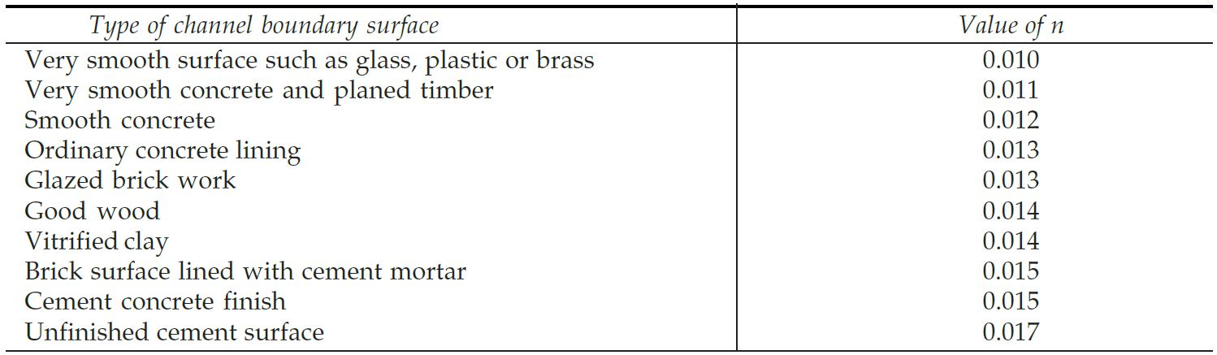
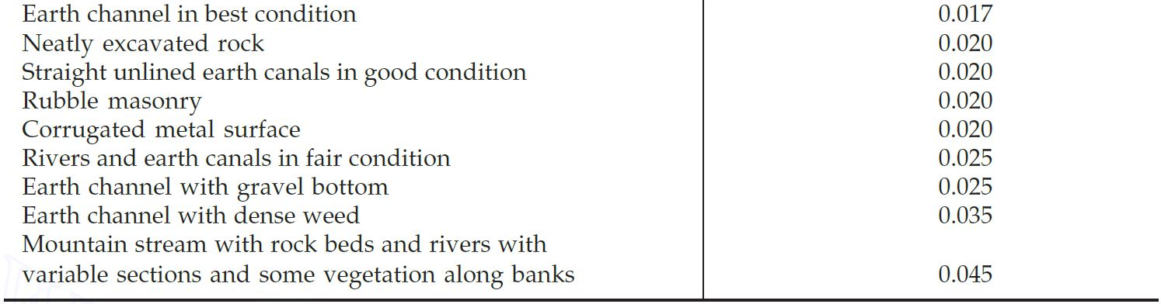
Uniform flow – manning n

Slide 34
Factors affecting manning n
It is not uncommon for engineers to think of a channel as having a single value of n for all occasions.
In reality, the value of n is highly variable and depends on a number of factors. In selecting a proper value of n for various design conditions.
The factors that exert the greatest influence upon the coefficient of roughness in both artificial and natural channels are therefore important for study.
It should be noted that these factors are to a certain extent interdependent; hence discussion about one factor may be repeated in connection 'with another'.

Slide 35
Factors affecting manning n
Vegetation
Surface Roughness
Channel Irregularity
Channel Alignment
Silting and Scouring
Obstruction
Size and Shape of the Channel
Stage and Discharge
Seasonal Change
Suspended Material and Bed load.

Slide 36
Factors affecting manning’s n
Vegetation
Vegetation may be regarded as a kind of surface roughness, but it also markedly reduces the capacity of the channel and retards the flow. This effect depends mainly on height, density, distribution and type of vegetation.
The effect of vegetation on flood plains are also important to be considered
It is very important in designing small drainage channels.

Slide 37
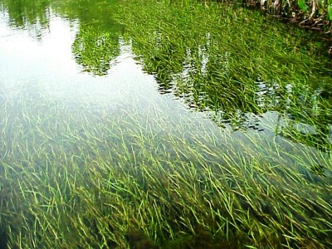
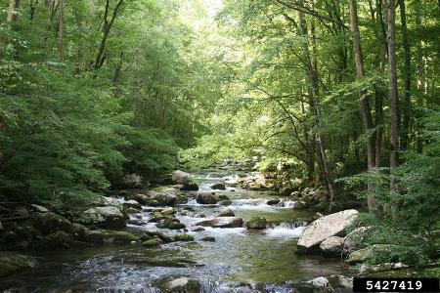
Factors affecting manning’s n
Vegetation

Slide 38
Factors affecting manning’s n
Surface Roughness
The surface roughness is represented by the size and shape of the grains of the material forming the wetted perimeter and producing a retarding effect on the flow. This is often considered the only factor in selecting a roughness coefficient, but it is actually just one of several major factors.
Generally speaking, Fine Grains result in a relatively low value of n and Coarse Grains, in a high value of n.
In Alluvial Streams where the material is fine in grain, such as sand clay, loam, or silt, ,the retarding effect is much less than where the material is coarse such as gravel; or boulders.

Slide 39
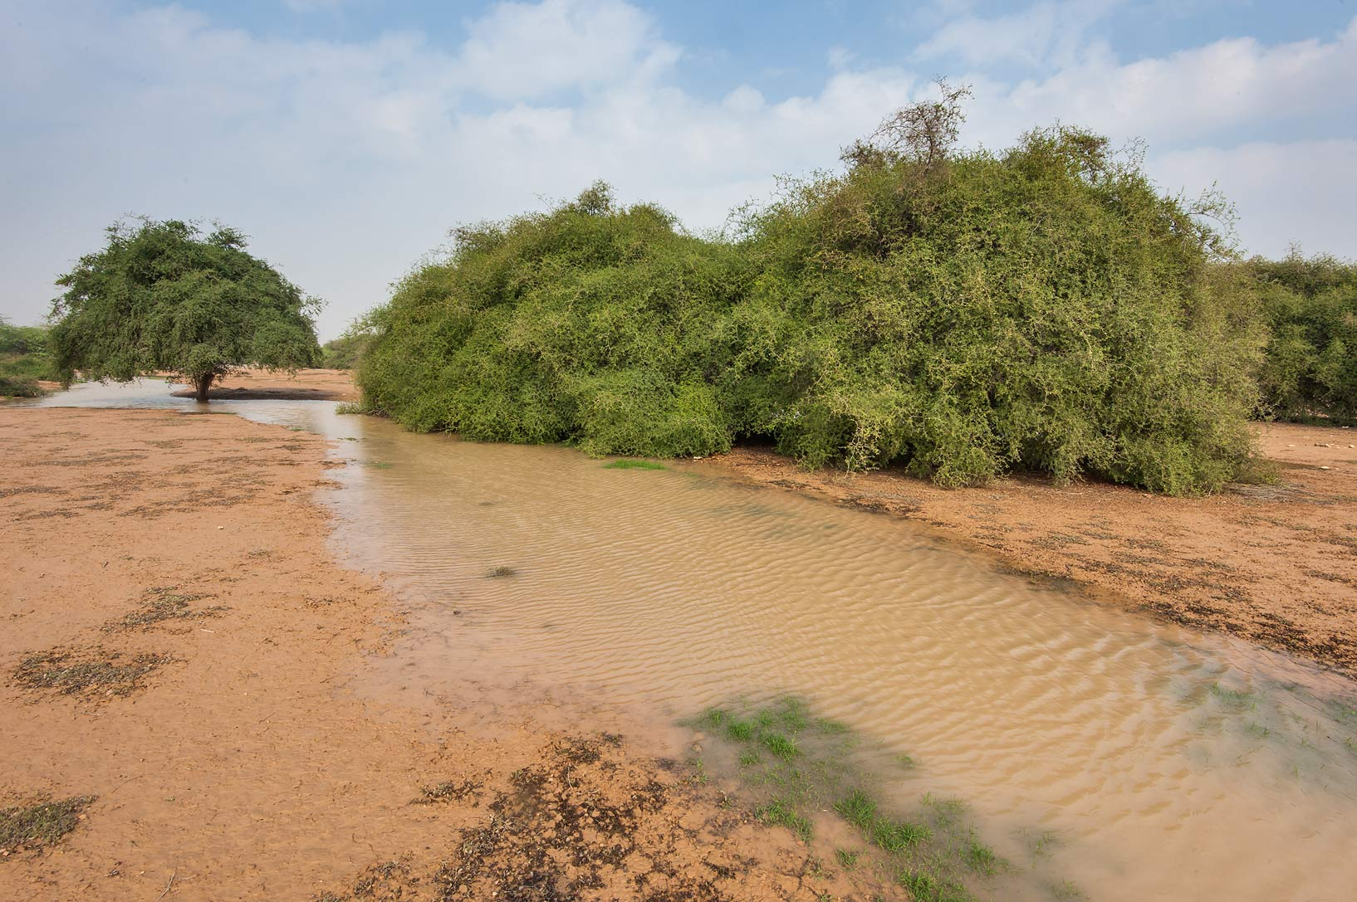
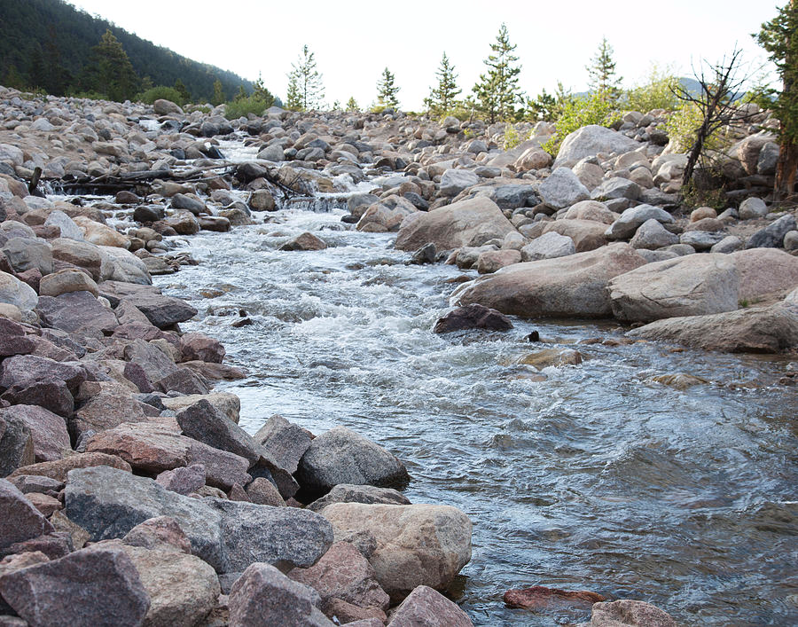
Factors affecting manning’s n
Surface Roughness

Slide 40
Factors affecting manning’s n
Channel Irregularity
Channel irregularity comprises irregularities in wetted perimeter and variations in cross section, size, and shape along the channel length.
In natural channels, such irregularities are usually introduced by the presence of sand bars, sand waves, ridges and depressions, and holes and humps on the channel bed.
These irregularities definitely introduce roughness in addition to that caused by surface roughness and other factors.
A Gradual and Uniform change in cross section, size, and shape will not appreciably affect the value of n, but abrupt changed or alternation of small and large sections necessitates the use of a large value of n.

Slide 41
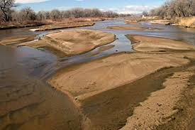
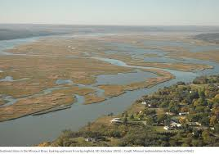



Factors affecting manning’s n
Channel Irregularity

Slide 42

Factors affecting manning’s n
Channel Alignment
Smooth Curvature with large radius will give a relatively low value of n, whereas Sharp Curvature with severe meandering will increase n.

Slide 43
Factors affecting manning’s n
Silting and Scouring
Silting may change a very irregular channel into a comparatively uniform one and decrease n.
Scouring on the other hand may do the reverse and increase n.
However, the dominant effect of silting will depend on the nature of the material deposited. Uneven deposits such as sand bars and sand waves will increase the 'roughness’.
The amount of uniformity of scouring will depend on the material forming the wetted perimeter. Thus, a sandy or gravelly bed will be eroded more uniformly than a clay bed.

Slide 44





Factors affecting manning’s n
Silting and Scouring

Slide 45
Factors affecting manning’s n
Obstruction
The presence of log jams, bridge piers, and the like things tends to increase n. The amount of increase depends on the nature of the obstructions, the size, shape, number, and distribution.
Size and Shape of Channel
There is no definite evidence about the size and shape of a channel as an important factor affecting the value of n. An increase in hydraulic radius may either increase or decrease n, depending on the condition of the channel ( as happens in a multi stage channels) .

Slide 46




Factors affecting manning n
Obstruction

Slide 47
Factors affecting manning’s n
Stage and Discharge
The n value in most streams decreases with increase in stage and in discharge.
When the water is shallow, the irregularities of the channel bottom are exposed and their effects become pronounced.
If the bed and banks of a channel are equally smooth and regular and the bottom slope is uniform, the value of n may remain almost the same at all so a constant is usually assumed in the flow computation. This happens mostly in artificial channels.
On flood plains the value of n usually varies with the stage of submergence of the vegetation at low stages.

Slide 48
Factors affecting manning’s n
Seasonal Change
Owing to the seasonal growth of aquatic plants, grass, weeds, willow, and trees in the channel or on the banks, the value of n may increase in the growing season and diminish in the dormant season.
Suspended Material and Bed Load
The suspended material and the bed load, whether moving or not moving, would consume energy and cause head loss or increase the apparent channel roughness.

Slide 49
Factors affecting manning’s n
All the above factors should be studied and needs to be evaluated to provide a basis for determining the proper value of n for a given problem.
As a general guide to judgment it may be accepted that conditions tending to induce turbulence and cause retardance will increase n value and that those tending to reduce turbulence and retardance will decrease n value.
Recognizing several primary factors affecting the roughness coefficient, Cowan developed a procedure for estimating the value of n.
$$n=\left(n_{0}+n_{1}+n_{2}+n_{3}+n_{4}\right)m_{5}$$

Slide 50
Factors affecting manning’s n
$$n=\left(n_{0}+n_{1}+n_{2}+n_{3}+n_{4}\right)m$$
where n₀ is a basic n value for a straight, uniform, smooth channel in the natural material involved,
n₁ is a value added to correct for the effect of surface irregularities,
n₂ is a value for variations in shape and size of the channel cross section
n₃ is a value for obstructions,
n₄ is a value for vegetation and flow conditions
m is a correction factor for meandering of channel
Proper values of n, and m, may be selected from a standard Table (Chow) according to the given conditions.

Slide 51

Factors affecting manning’s n

Slide 52


Factors affecting manning’s n

Slide 53


Factors affecting manning’s n

Slide 54
numerical
Q1. A smooth concrete-lined channel has trapezoidal cross-section with base width 6m and side-slopes 1V:2H. If the bed slope is 1 in 500 and the normal depth is 2m, calculate the quantity of flow.

Slide 55
numerical
Q2. For the above channel, if the quantity of flow is 40m³/s. What is the normal depth?

Slide 56


